Slide 1
3D Reconstruction Tool based on Multi-View images
Rao, Hongyi
Wang, Jiahao
Sprint 4 - Group 18: Zhang, Yiqin

Slide 2
Background
Multi-view stereo (MVS) uses multiple images taken by one/multiple camera(s) to reconstruct the 3D scene.
Notes:
Multi-view stereo (MVS) is a general term for a series of methods for 3D reconstruction.
The task is reconstructing a 3D shape from calibrated overlapping images captured from different viewpoints.
Multi-view stereo (MVS) uses multiple photos taken by one/more cameras to reconstruct the 3D scene in the picture.

Slide 3
Goal:
To create an Assisted Modeling Tool
To meet the needs of designers, game developers, architects, engineers, and people who frequently do modeling.
Notes:
The mission is to reconstruct a complete 3D object model from a collection of images taken from known camera viewpoints.

Slide 4
Method

Slide 5
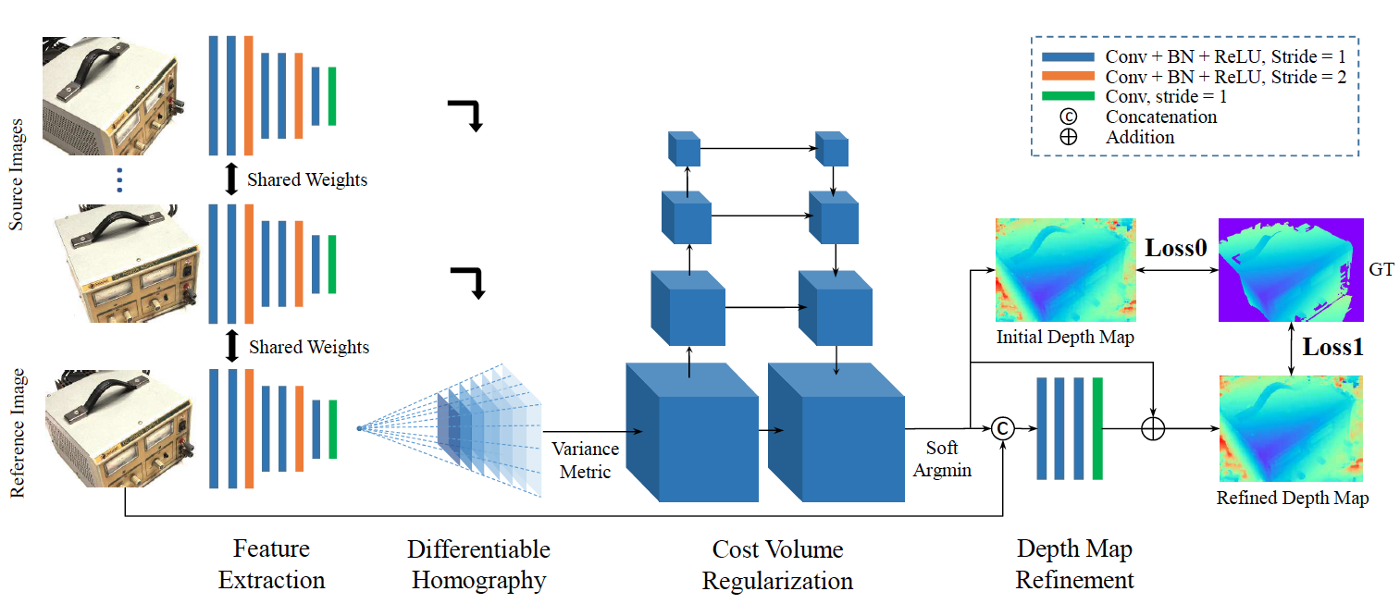
MVSNet
End-to-end MVS learning framework
Camera geometry encoded as differentiable homography
Variance-bacd Cost Metric for N-view similarity
Notes:
MVSNet is the method we are working on. It's an End-to-end MVS learning framework.
MVSNet takes one reference image and several source images as input, infers the depth map for the reference image, and then uses the convolutional network to obtain the feature maps.
The key insight here is the differentiable homography warping operation. It implicitly encodes camera geometries in the network to build the 3D cost volumes from 2D image features.
Variance-based metric maps multiple features into one cost volume. It makes it possible to adapt an arbitrary number of source images in the input.

Slide 6
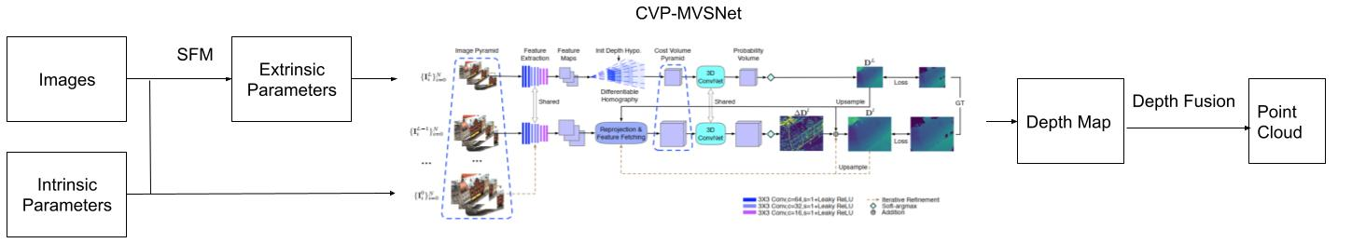
Workflow

Slide 7
SFM (Structure from motion)
1.Use SIFT to get corners that represent an image's character.
2.Math the corners of the input image to get the ten pictures with the most similar features.
3.Take the first image as a reference and obtain the extrinsic parameters of the most similar image and initialize a 3D model.
4.Based on the 3D model, use reprojection to obtain extrinsic parameters of other images.
Notes:
SFM(Structure for motion) algorithm refers to estimating 3D structure from a sequence of moving 2D images.It is valuable for MVS reference.

Slide 8
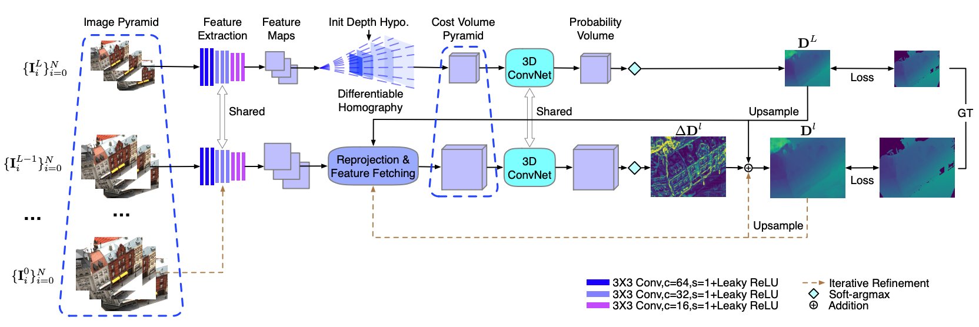
Network Structure
•Input the obtained extrinsic parameters, together with images and intrinsic parameters, into the CVP-MVSNet to generate depth maps.
•Fuse multiple depth maps to form the point cloud.

Slide 9
CVP-MVSNet
CVP-MVSNet (CVPR 2020 Oral) is a cost volume pyramid based depth inference framework for Multi-View Stereo.
CVP-MVSNet is compact, lightweight, fast in runtime and can handle high resolution images to obtain high quality depth map for 3D reconstruction.
The intrinsic parameters: the focal length and lens distortion, etc.
The extrinsic parameters: describe the transformation between the camera and its external world.

Slide 10
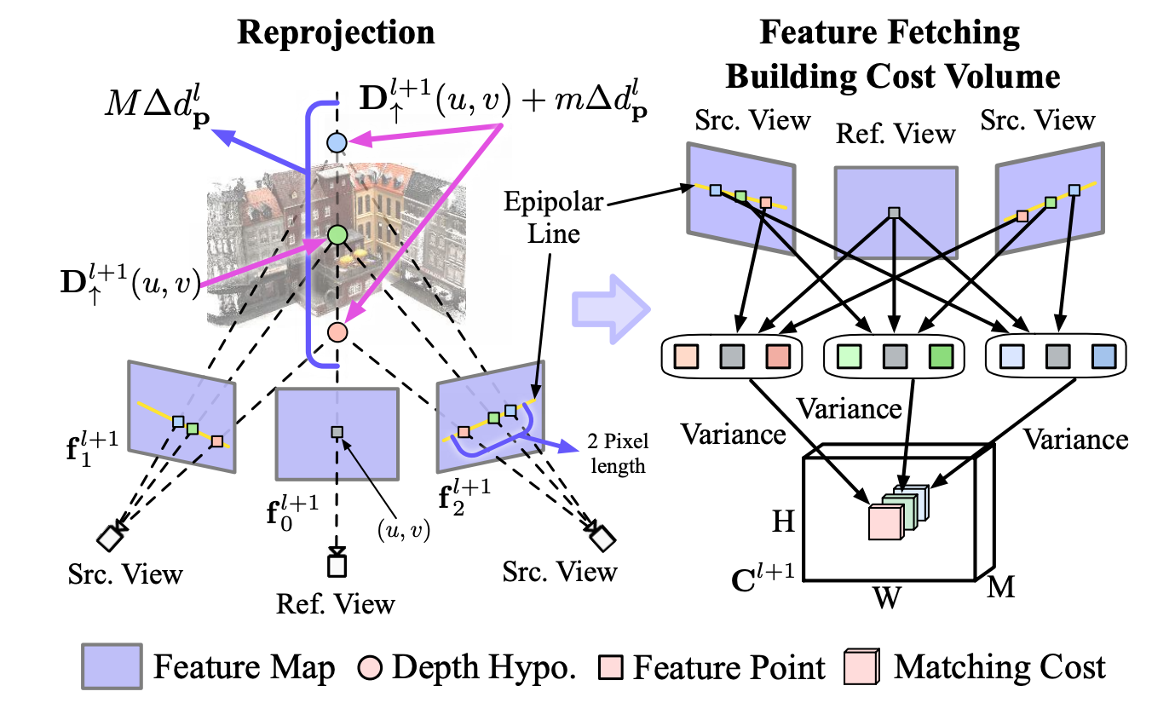
Feature Fetching & Building Cost Volume
Left: define M depth hypotheses for each pixel (u, v) in the reference view. project them to each source view to fetch M corresponding features.
Right: For each depth hypothesis, the matching cost is the variance of fetched features across source views and the reference view. The cost volume Cl+1 defines matching costs for all depth hypotheses of all pixels in the reference view.

Slide 11
Result
Notes:
Technologies

Slide 12
Training
We train our CVP-MVSNet on DTU training set.
Depth map: reflects the distance of the object from the origin.
Probability map: reflects the depth estimation quality.

Slide 13
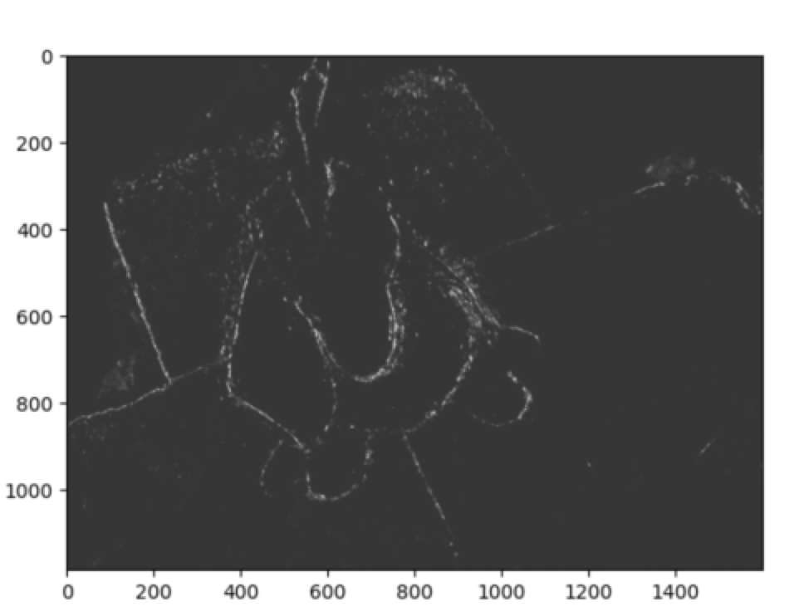
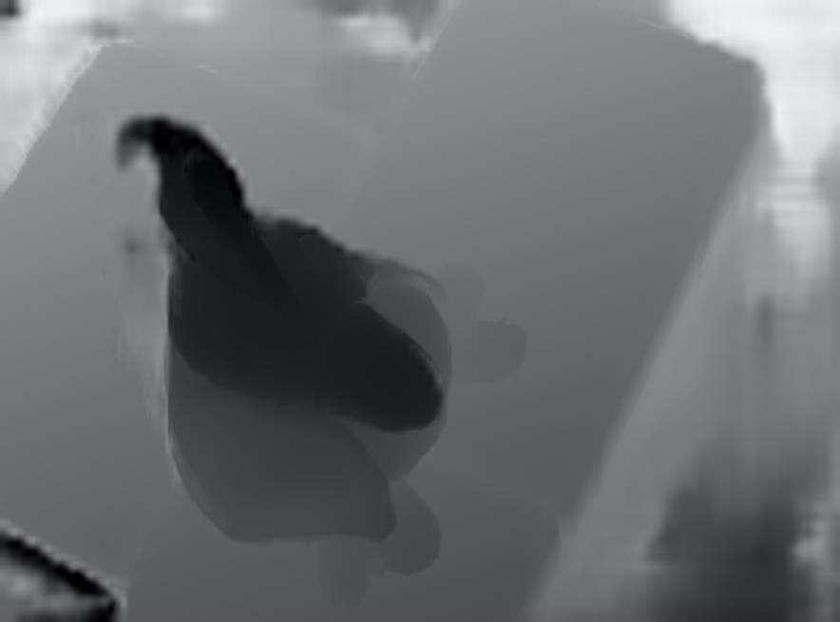
Standard
Depth Map Probability Map

Slide 14
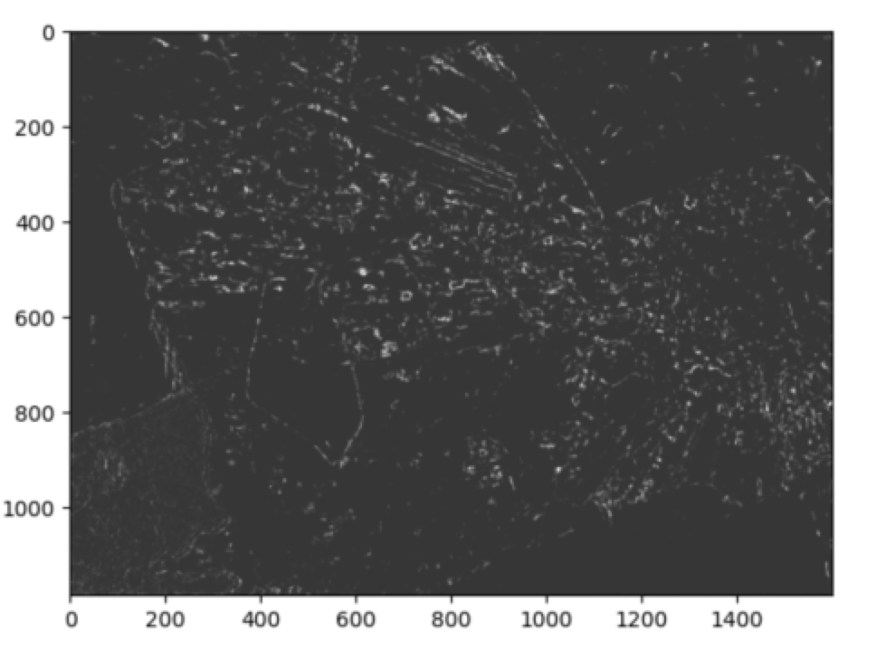
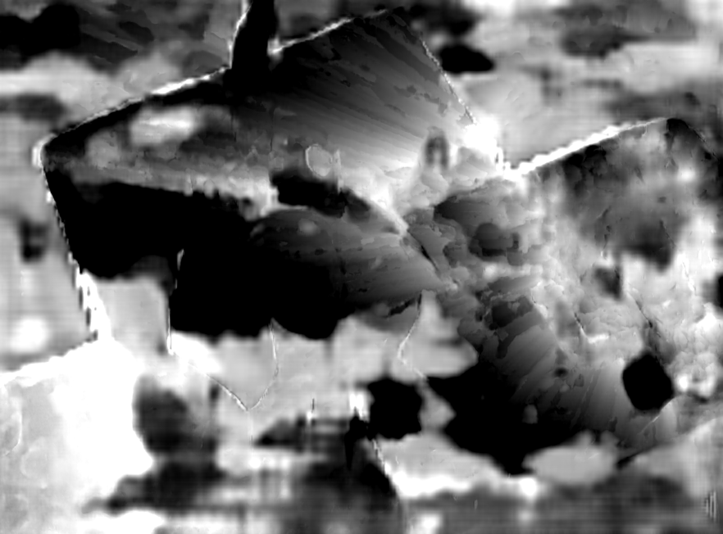
Our Result
Depth Map Probability Map

Slide 15
Result
Due to the slight error of the camera’s extrinsic parameters obtained by SFM, the image block is shifted and misaligned.
The SFM algorithm causes the error of the camera’s extrinsic parameters to gradually add up, which should be improved in the future.

Slide 16
Next Step
1.Increase the accuracy, especially the algorithm to get extrinsic parameters.
2.Reduce the running time.
3.Achieve the performance without converting the resolution of the input image.
4.Improve the interactive user interface.

